Slide 1


The Sparks Foundation
Graduate Rotational Internship Program
Data Science & Business Analytics Tasks.
Author: Priyanka Biswas

Slide 2



Business Problem:
Perform ‘Exploratory Data Analysis’ on dataset ‘Sample Superstore’ , As a business manager, try to find out the weak areas where you can work to make more profit.
Objective:
Exploratory Data Analysis - does this for Machine Learning enthusiast. It is a way of visualizing, summarizing and interpreting the information that is hidden in rows and column format.
Once EDA is complete and insights are drawn, its feature can be used for supervised and unsupervised machine learning modelling.

Slide 3
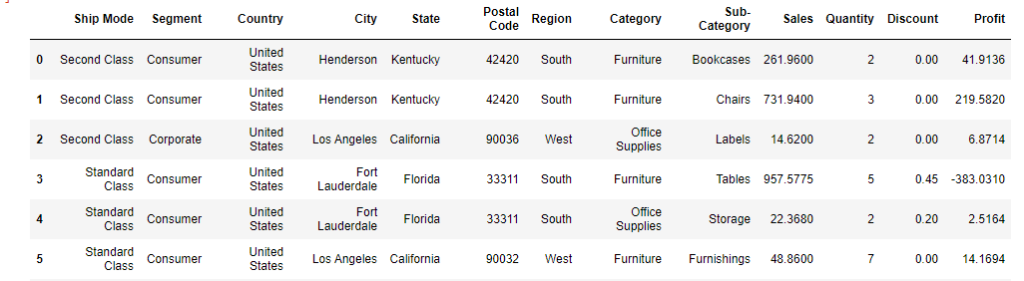
Data set details:
The dataset contains total 9994 records of columns contains Ship Mode, Segment, Country, City, State, Postal Code, Region, Category, Sub-Category, Sales, Quantity, Discount, Profit.

Slide 4
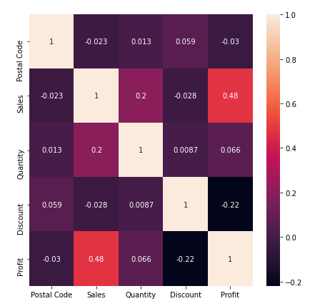
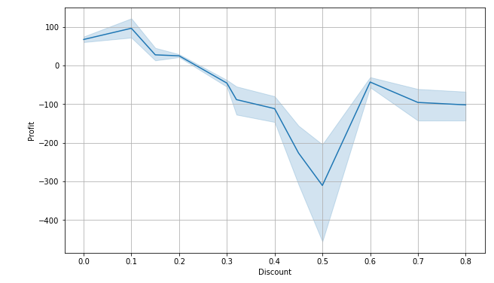
Eda:
Pair Plot & Line Plot

Slide 5
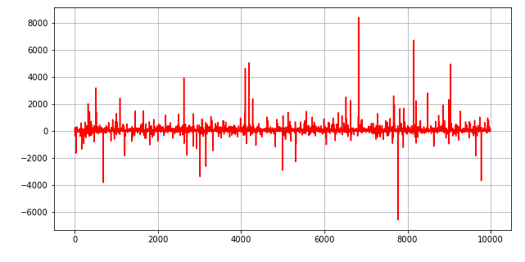
Eda:

Slide 6
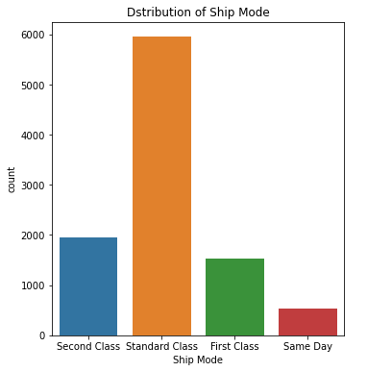
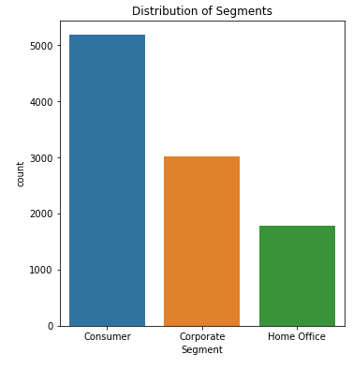
Eda:

Slide 7
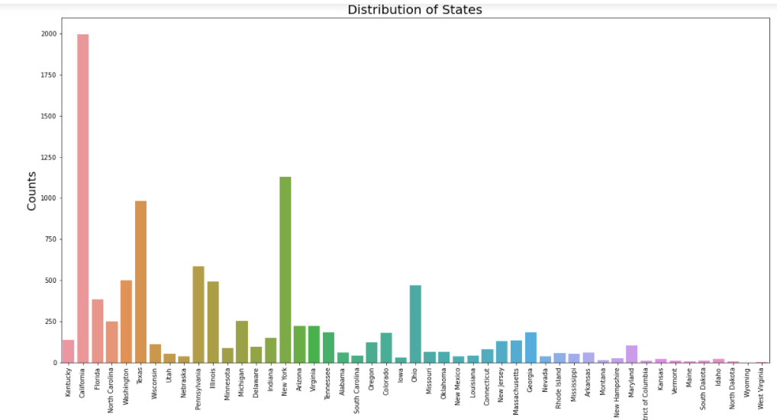
Eda:

Slide 8
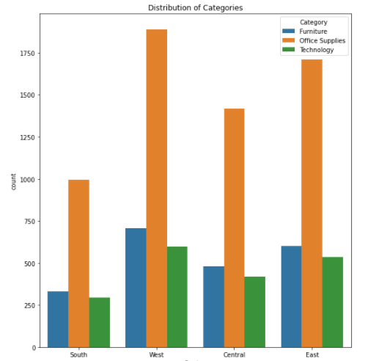
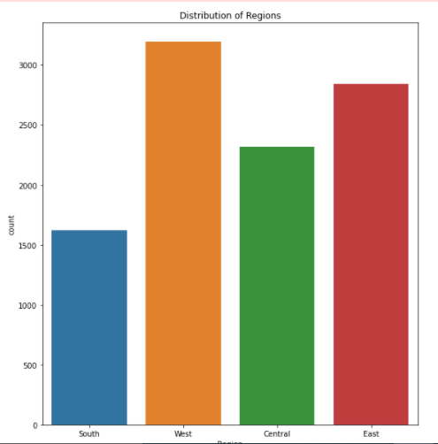
Eda:

Slide 9
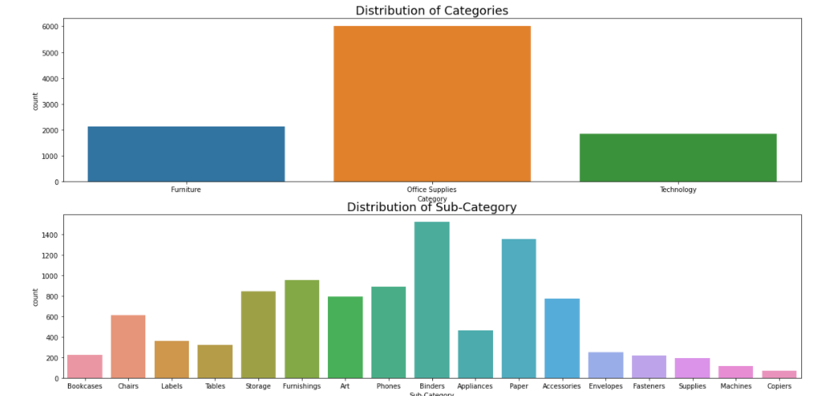

Slide 10
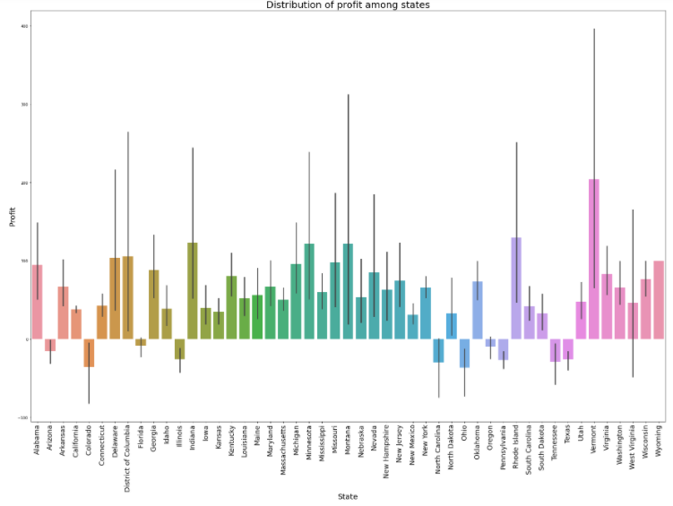
Eda(profit among state):

Slide 11
Thank you

